Slide 1
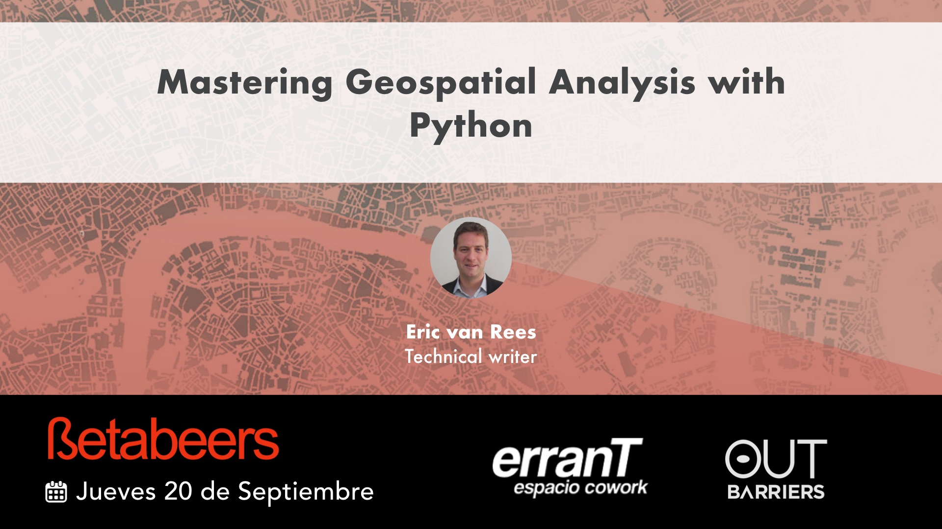

Slide 2
About Me
Born Dutch, studied Human Geography
Self-taught Python developer
Remote freelance technical writer
Contact:
www.ericvanrees.com
eric@ericvanrees.com

Slide 3
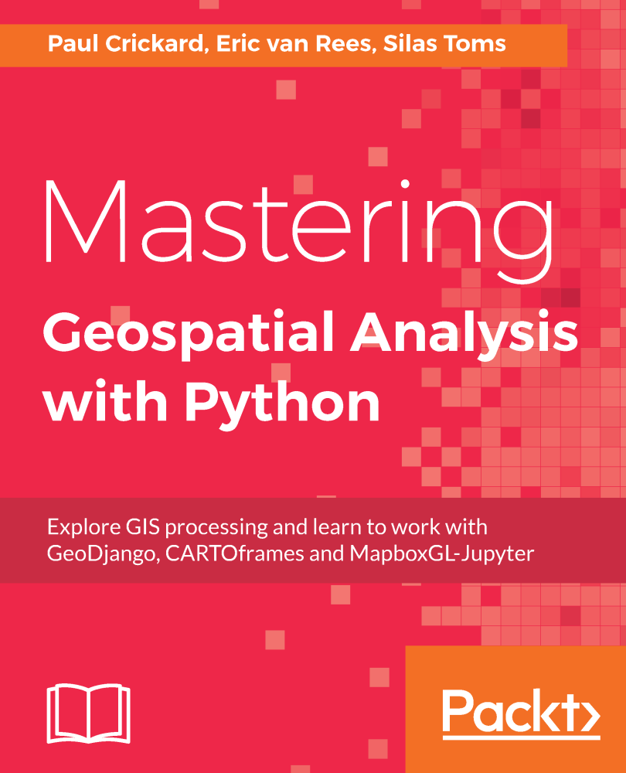
New book: Released in May 2018
Paper + eBook
Comes with examples code files
400 pages
Learning by doing:
Software Tutorials
Best practices
Tips & Tricks

Slide 4
What is python?
Python is a high-level programming language
Has human-readable syntax
Is very popular among beginning programmers
Has a huge ecosystem of freely available code libraries
Has an active and helpful community (newsgroups, local /national/int. events)
Can be used for scripting purposes, as well as building applications
Many free, open source spatial Python libraries available for automating and executing spatial analysis (raster + vector)
These integrate very well with other Python libraries:
… for example Machine Learning, Data Science…

Slide 5
Why did we write this book?
No book available yet that covers Python 3 spatial libraries, only Python 2
Nothing available on data visualization with Jupyter Notebooks (or JupyterLab)
Nothing available on new cool Python libraries from Esri, Carto and Mapbox
No high-level overview available for spatial libraries

Slide 6
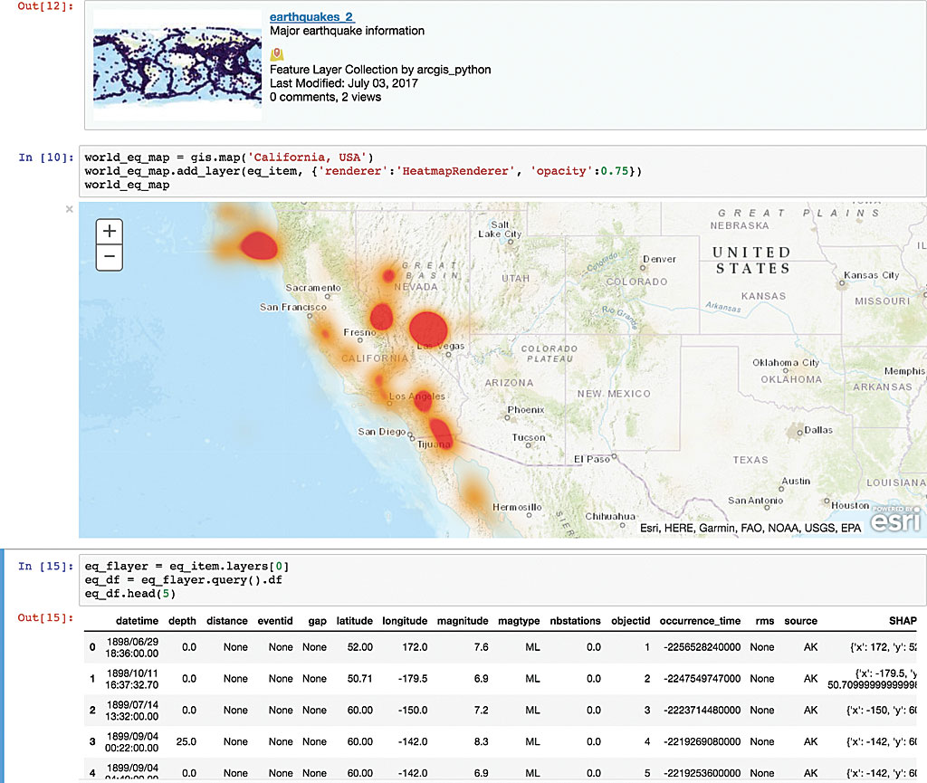

Slide 7
Looking for a place to start?
Learn Essential Spatial Python libraries:
GDAL/OGR/Geoss/Shapely: read/write/data conversion/geographical operations/reprojections
More “pythonic libraries” that do the same thing: Fiona, Shapely, Rasterio

Slide 8
Python is the “glue” that Ties everything together:
Desktop: GIS + Python + Spatial Database (PostGIS)
OR: Python only ( w/ optional spatial database)
Web: Server-based GIS, Python (Flask, GeoDjango) + Local Database/Files
Cloud: Cloud-based GIS Platform, w/Python and Desktop Client / OR: cloud big data processing

Slide 9
Code example: Geopandas
Pandas cannot read spatial data, but GeoPandas does
Adds 2 subclasses to pandas data objects: GeoSeries and GeoDataframes
Read and visualize shapefile attribute tables easily – no more for loops
Perform spatial analysis and plot the results on an map

Slide 10
Goal: count wildfires per state
Map #1:US state polygons

Slide 11
Map #2, point data of all wildfires 1984-2015

Slide 12
As our geodataframe is a pandas object, we can count and rank the counts:

Slide 13
Finally, this map ranks all state based the total count per state field:

Slide 14
Spatial join of points and polygons

Slide 15
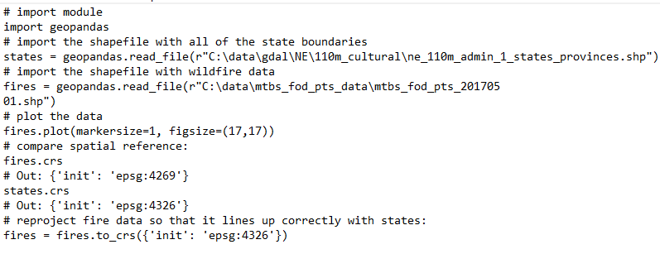

Slide 16
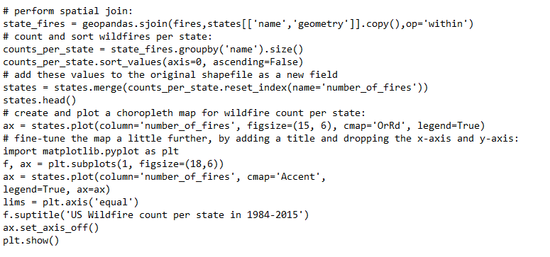

Slide 17
Thank You!
https://www.packtpub.com/application-development/mastering-geospatial-analysis-python
Any questions?
ericvanrees@gmail.com
eric@ericvanrees.com
Twitter: @geospatialprof

